Slide 1
Cooperation Systems – Interim presentation Visual augmented reality manual support
A. Droste, A. Machmer, A. Mantel, J. Schwede
Department for computer science
17th of January 2019

Slide 2
Our cooperation system (1/2) – idea
AR support for the collaborative usage of (operation) manuals
e.g. build your furniture together with additional complementary information
Supporting through Augmented Reality
Different roles possible but not necessary
“Searcher”
“Builder”

Slide 3
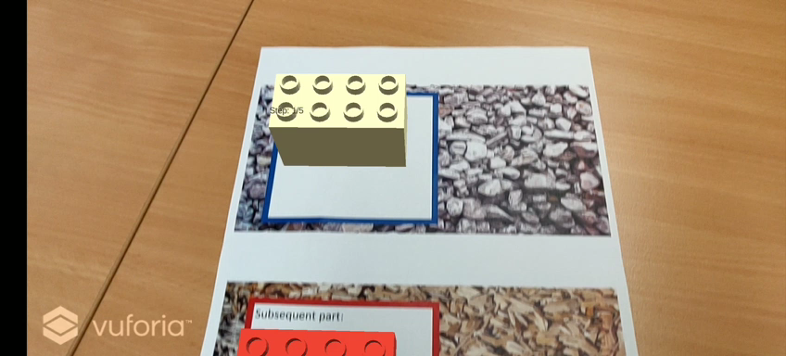
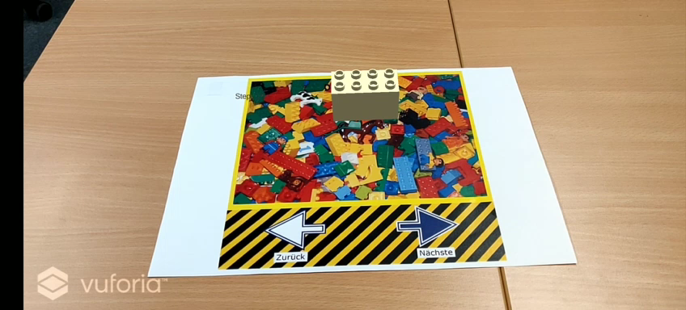

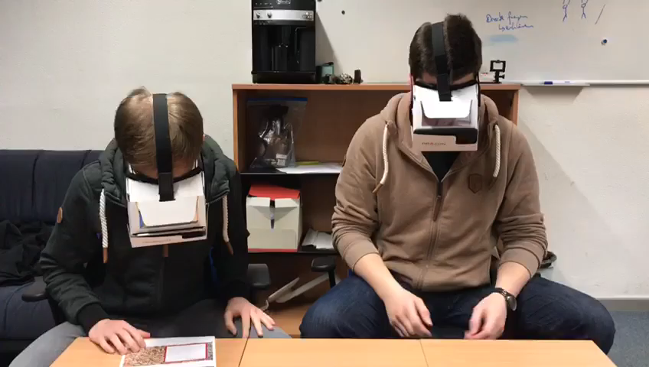
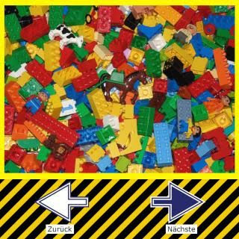

Our cooperation system (2/2) – prototype
Marker for searcher (show next parts)
Marker for builder (show steps to assemble)

Slide 4
Concepts for this cooperation system
Social interaction and coordination tool
Roomware
Awareness
All parties are always aware of the progress and the actual following task
Synchronous bidirectional communication support
Co-located (AR shared space)
In general a symmetric system design (Exploring, working on the same content, build/assemble the furniture together (teamwork))
Can also be used in an asymmetric scenario (Helper-Expert)

Slide 5
Plan for evaluation
user studies
Questionnaires (pre/post)
How do you feel supported? (with traditional paper manuals/with AR supported manuals)
Were you always aware of the tasks of you partner?
…
Interviews
flexibility
Kirkpatrick Model
Reaction – Do the users need this support?
Learning – Can users work better together to build their furniture?
(Transfer) – Can they use the knowledge with different manuals?
(Results)

Slide 6
Planned improvements for the system
transparency of bricks in modell to show progress (improve awareness)
add properties of parts to list of next parts
network manager improvements for collaborative task
Synchronize tasks between users

Slide 7
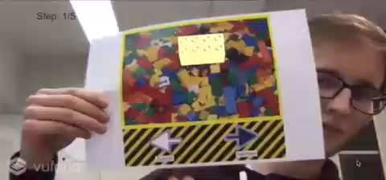
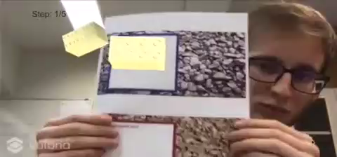
Our cooperation system (2/2)
Marker for builder (show steps to assemble)
Marker for searcher (show next parts)

